Slide 1

Introduction to Machine Learning with Python
GW Coders Meet-up
March 12, 2020

Slide 2
Learning objectives
What is Machine Learning
Applications
Types
Supervised Learning
Linear Regression
Deep Learning
Neural Network
Perceptron
Convolutional Neural Network
Case study: Facemask Detector
Coding Session
Key Takeaways
Outline

Slide 3
Learning Objectives
Understand the basics of Machine Learning and Deep Learning
Develop mathematical intuition behind Machine Learning and Deep Learning
Understand the basics of programming in Machine Learning and Deep Learning

Slide 4
Who is this for?
Little to no background in Machine Learning/Deep Learning
Basic understanding of Linear Algebra and Calculus (high school/Freshman)
Basic understanding of python programming

Slide 5
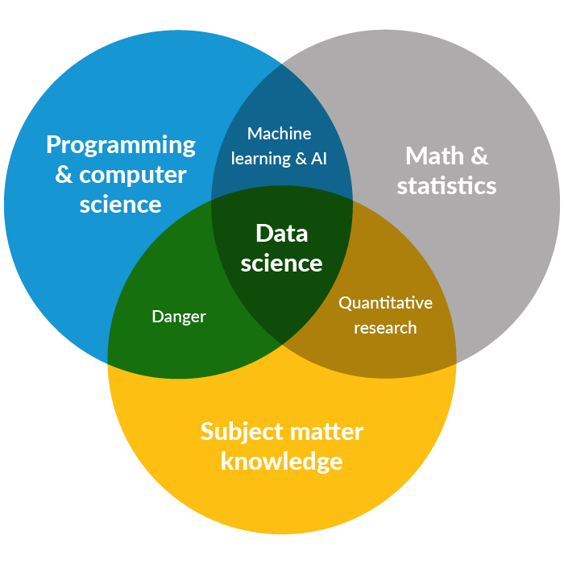
Data Science Venn Diagram
Source: Drew Conway – The Data Science Venn Diagram

Slide 6
Machine Learning
Machine Learning is the programming of computers so they can learn from input data
Learning is the process of acquiring knowledge/skills through experience
Machine Learning is a branch of Artificial Intelligence that enables computers perform tasks without explicitly programmed

Slide 7
Machine Learning: Applications
Medical:
Cancer analysis, hospital quality management, cost reduction
Banking:
Credit evaluators, Predicting loan recovery rates
Entertainment:
Movie recommendation, Music recommendation
Social Media:
Chatbots, Spam filter, Fake News detection, Recommendation
Mining (Oil and Gas):
Predictive maintenance of equipment

Slide 8
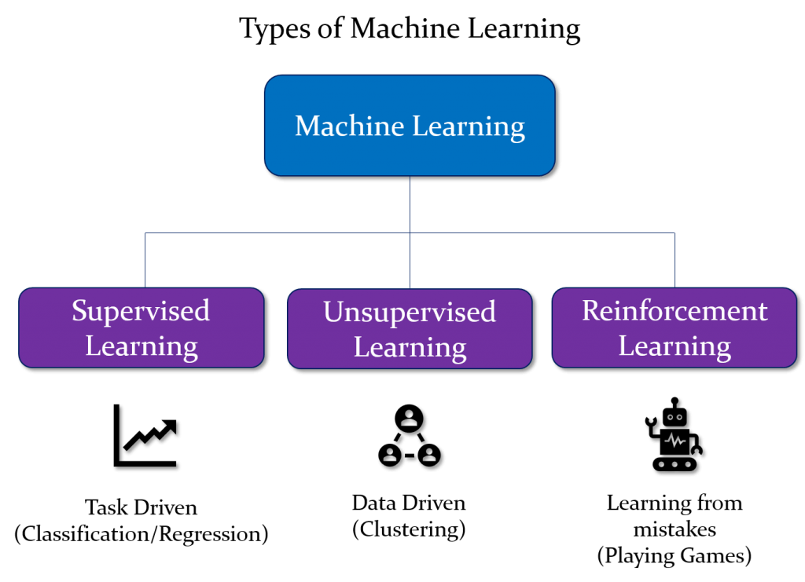
Machine Learning: Types

Slide 9
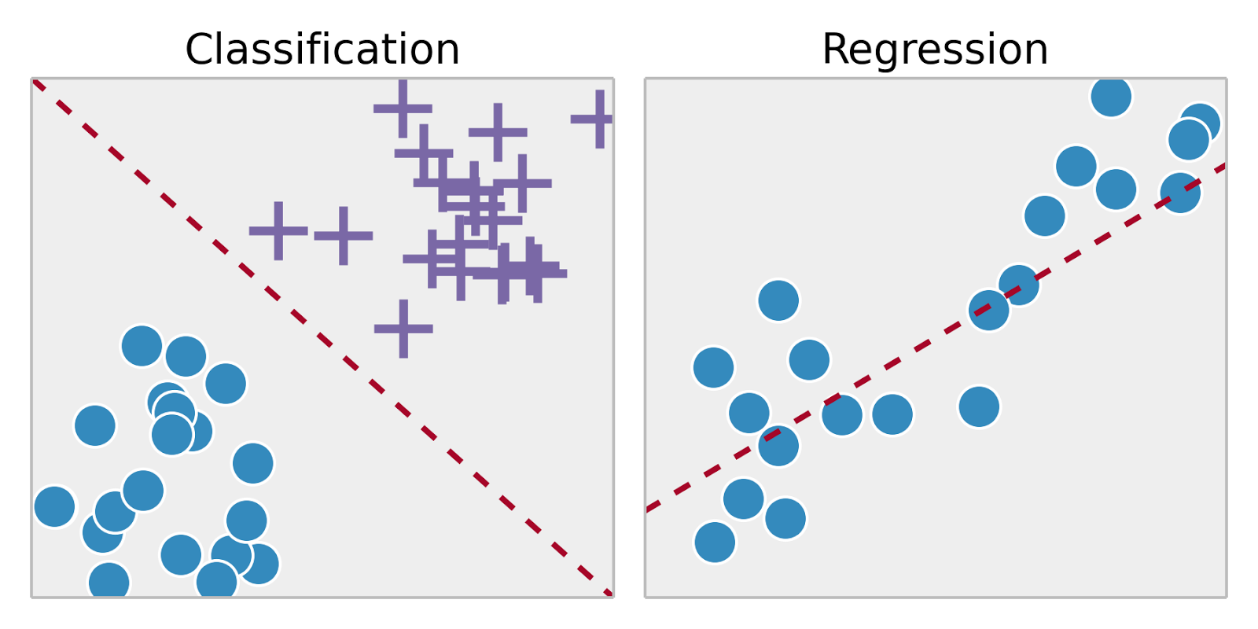
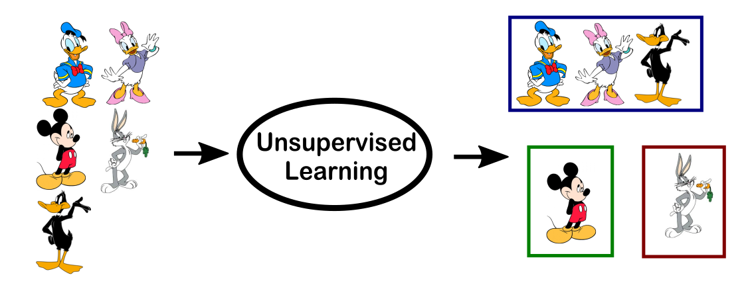

Machine Learning: Types
Supervised learning:
To learn a function that best approximates the relationship between input and output
Unsupervised Learning:
To infer a function/structure present within a set of data
Reinforcement Learning
To map situations to actions

Slide 10
Machine Learning: Supervised Learning
Supervised learning:
To learn a function that best approximates the relationship between input and output
Regression Problems: The output is continuous. Examples of common algorithms include: Linear Regression, Generalized Linear Regression, Neural Networks
Classification Problems: The output labels are discrete. Examples of common algorithms include: Logistic regression, Support Vector Machines (SVM), Naïve Bayes, Decision Trees, K-Nearest Neighbors, Neural Networks

Slide 11


Machine Learning: Linear Regression
A simple linear regression attempts to shows the relationship between two quantities
A multiple linear regression attempts to model the relationship between one continuous dependent variable and two or more independent variables
Example: Create a linear model to predict the price of an automobile

Slide 12
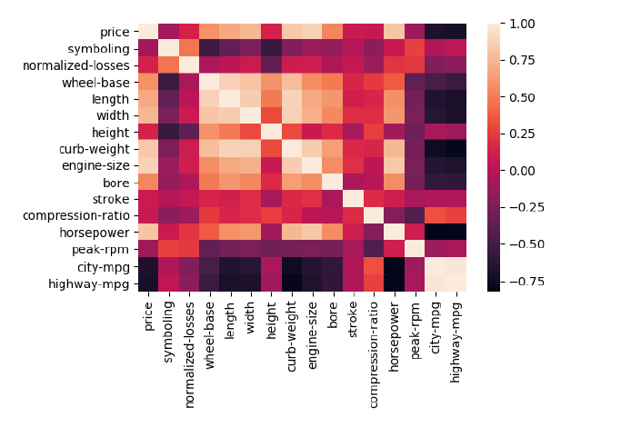
Machine Learning: Linear Regression

Slide 13
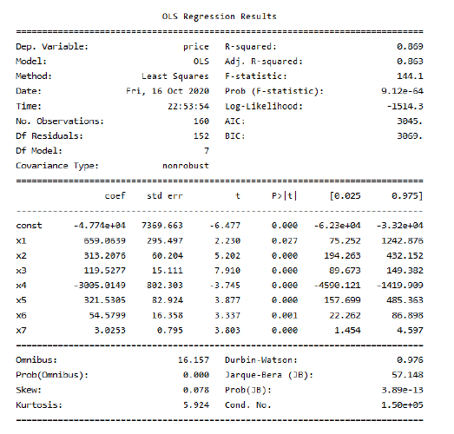
Machine Learning: Linear Regression

Slide 14
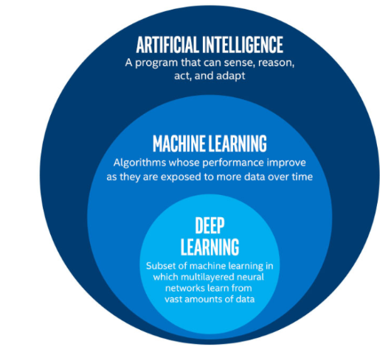
Deep Learning
”Deep learning is a part of a broader family of machine learning methods based on learning data representations, as opposed to task-specific algorithms. Learning can be supervised, partially supervised or unsupervised.”
Deep Learning is inspired by the structure of the human brain. It uses a multi-layered structure of algorithms called neural networks

Slide 15
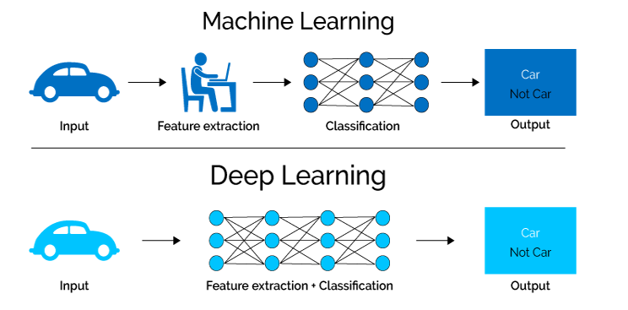
Deep Learning
It is suitable for large amount of data and features
It can easily extract features from unstructured data
It can identify very complex patterns

Slide 16
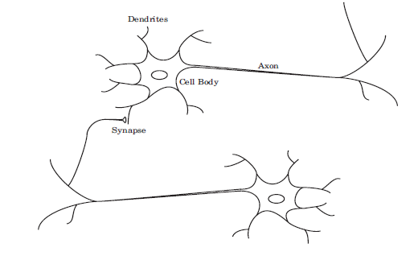
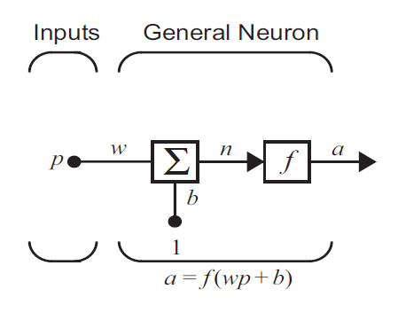
Deep Learning: Neural Network

Slide 17
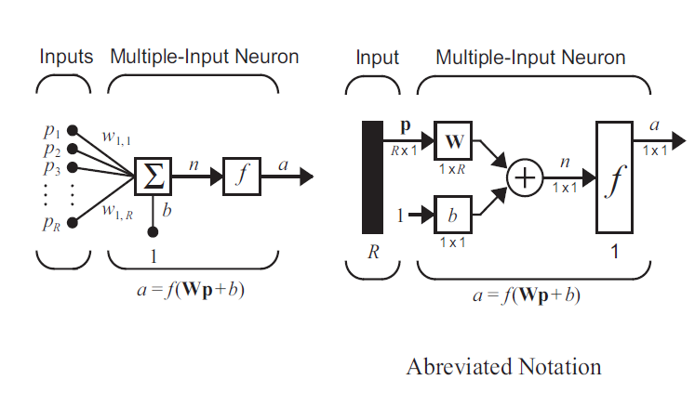
Deep Learning: Neural Network

Slide 18
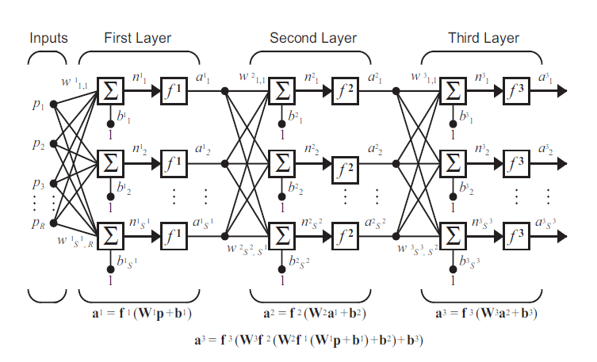
Deep Learning: Neural Network

Slide 19
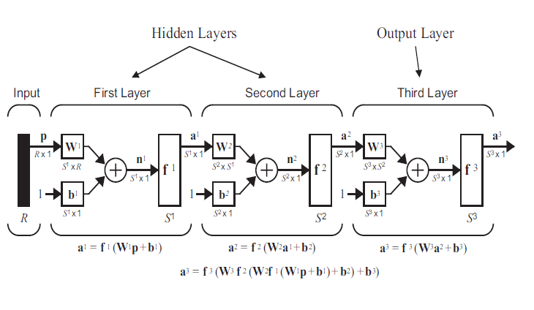
Deep Learning: Neural Network

Slide 20
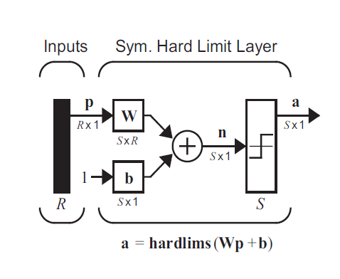
Deep Learning: Perceptron

Slide 21
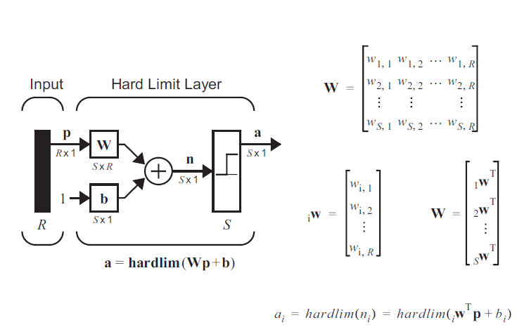
Deep Learning: Perceptron

Slide 22
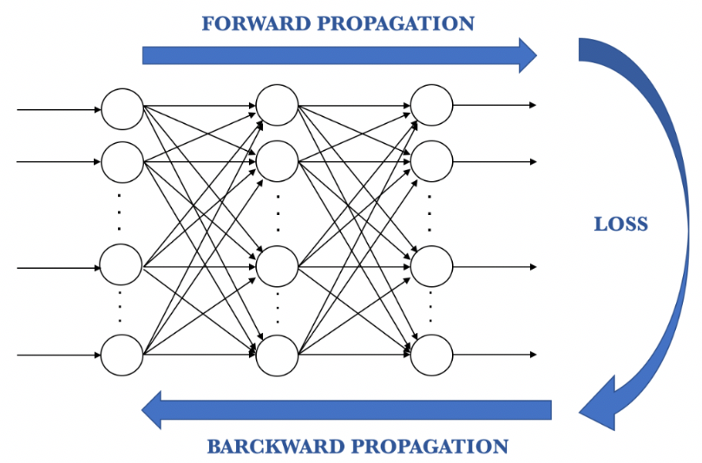
Deep Learning: Training a Neural Network
Feedforward pass
Calculation of error
Optimization (gradient descent)
Backpropagation

Slide 23
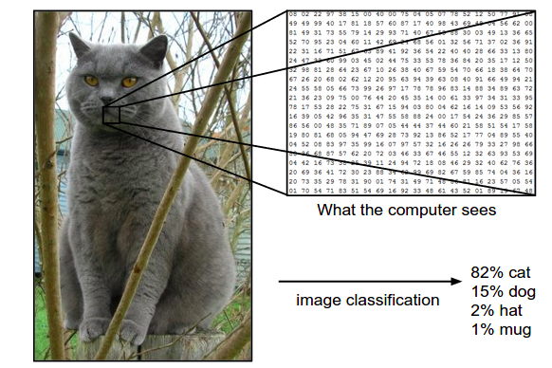
Deep Learning: Convolutional Neural Network (CNN)
It is modeled after the primary visual cortex of the brain
The complex hierarchical structure of neurons and connections in the brain play a major role in how we process remembering and labelling objects

Slide 24
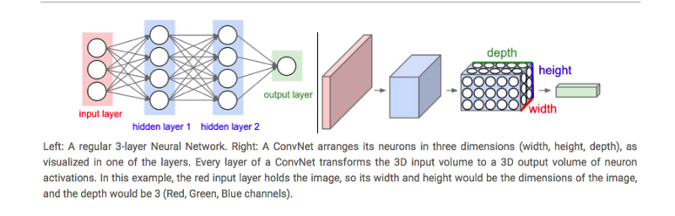
Deep Learning: Convolutional Neural Network (CNN)
The CNN Architecture consists of two parts:
The Feature Extraction part where convolutions and pooling takes place to detect features
The Classification part where extracted features are classified, with output probabilities
Normal NN
ConvNet

Slide 25
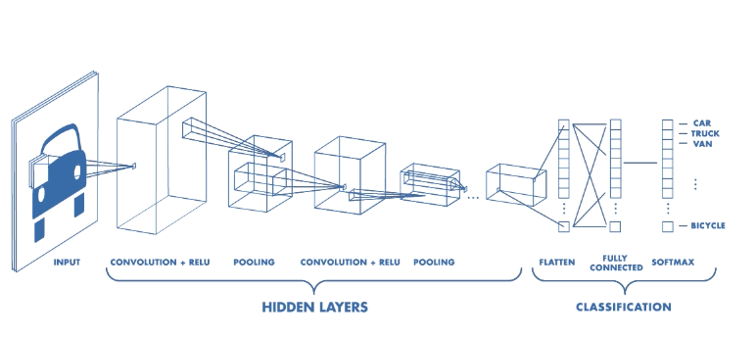
Deep Learning: Training a Neural Network
Optimization (gradient descent)
Backpropagation
Feedforward pass
Calculation of error

Slide 26

Case Study: Facemask Detector
Objective
To build a model to identify whether a face image is wearing a mask correctly, incorrectly or none
Acknowledgement
Ese Emuraye
Pragya Srivastava
Sheldon Sebastian

Slide 27
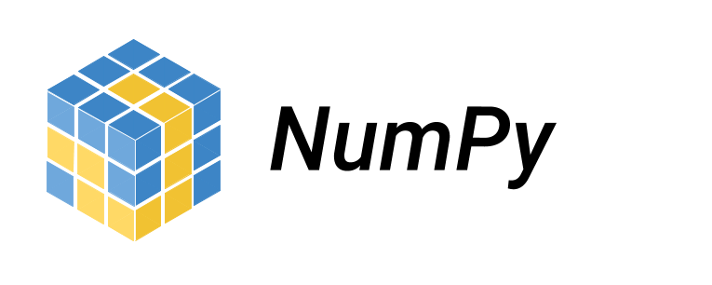


Coding Session
Python and Machine Learning

Slide 28



Coding Session
Deep Learning Frameworks

Slide 29
Key Takeaways
Machine Learning is the programming of computers to learn from input data
Deep Learning is a sub-field of machine learning inspired by the human brain
Supervised Learning involves learning a function that best approximates the relationship between input and output
Unsupervised Learning involves learning to infer a function/structure present within a set of data
Convolutional Neural Networks is modeled after the primary visual cortex of the brain

Slide 30
References
Amir Jafari (2020): Machine Learning 2 Fall 2020 Lecture Series
https://towardsdatascience.com/what-is-deep-learning-and-how-does-it-work-2ce44bb692ac
https://www.freecodecamp.org/news/an-intuitive-guide-to-convolutional-neural-networks-260c2de0a050/

Slide 31
Questions

